Slide 1
MODULE I
FUNDAMENTALS OF EMBEDDED SYSTEM

Slide 2
Syllabus
Complex systems and microprocessors
Embedded system design process
  Specifications
  Architecture design of embedded system
  Design of hardware and software components
Structural and behavioral description.

Slide 3
System
A system is a way of working, organizing or doing one or many tasks according to a fixed plan, program or set of rules.
A system is also an arrangement in which all its units assemble and work together according to the plan or program.

Slide 4
What is an Embedded system?
A system that has hardware with software embedded in it as one of its most important component and intended for a dedicated application.
A system that has embedded software and computer hardware, which makes it a system dedicated for an application(s) or specific part of an application or product or part of a larger system.

Slide 5
“A combination of computer hardware and software, and perhaps additional mechanical or other parts, designed to perform a dedicated function. In some cases, embedded systems are part of a larger system or product, as is the case of an antilock braking system in a car ”.
Embedded systems are electronic systems that contains microprocessor or microcontroller, but not computers

Slide 6
Definition
Embedded computing system: any device that includes a programmable computer but is not itself a general-purpose computer.
Take advantage of application characteristics to optimize the design:
  don’t need all the general-purpose bells and whistles.

Slide 7
Why do we need embedded systems?
It is because general-purpose computers, like PCs, would be far too costly for the majority of products that incorporate some form of embedded system technology (Christoffer, 2006).
Is because general-purpose solution might also fail to meet a number of functional or performance requirements such as constraints in power-consumption, size-limitations, reliability or real-time performance etc.
The colossal growth of processing power in small packages has fuelled the digital revolution. All sectors of the economy have been influenced by the digital revolution and the industry has experienced tremendous developments in all aspects of engineering disciplines (Bruce, 2011).

Slide 8
Embedded systems everywhere?
Embedded systems span all aspects of modern life and there are many examples of their use.
a) Biomedical Instrumentation – ECG Recorder, Blood cell recorder, patient monitor system, scanners
b) Communication systems – pagers, cellular phones, cable TV terminals, fax and trans receivers, video games and so on.
c) Peripheral controllers of a computer – Keyboard controller, DRAM controller, DMA controller, Printer controller, LAN controller, disk drive controller.

Slide 9
d) Industrial Instrumentation – Process controller, DC motor controller, robotic systems, CNC machine controller, close loop engine controller, industrial moisture recorder cum controller.
e)Scientific – digital storage system, CRT display controller, spectrum analyzer.
f) Military – control and monitoring of military equipment's.
g) Automobile controls – ABS, engine and transmission control, door and wiper control.

Slide 10
Advantages
Low cost
Small size
High reliability
Fast operations
Easy to manufacture
Fewer interconnections

Slide 11







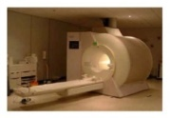


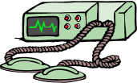


A “short list” of Embedded Systems
Anti-lock brakes
Auto-focus cameras
Automatic teller machines
Automatic toll systems
Automatic transmission
Avionic systems
Battery chargers
Camcorders
Cell phones
Cell-phone base stations
Cordless phones
Cruise control
Digital cameras
Disk drives
Electronic card readers
Electronic instruments
Electronic toys/games
Factory control
Fax machines
Fingerprint identifiers
Home security systems
Life-support systems
Medical testing systems
Modems
MPEG decoders
Network cards
Network switches/routers
On-board navigation
Pagers
Photocopiers
Point-of-sale systems
Portable video games
Printers
Satellite phones
Scanners
Smart ovens/dishwashers
Speech recognizers
Stereo systems
Teleconferencing systems
Televisions
and the list goes on and on…

Slide 12
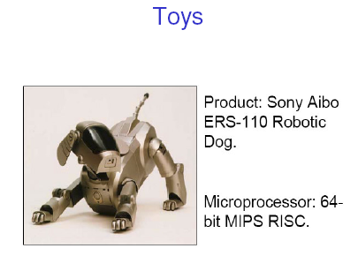
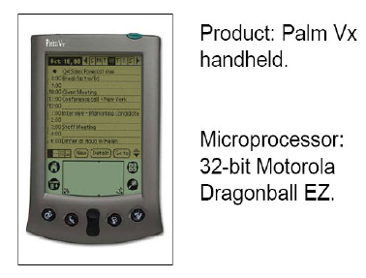
Application Examples

Slide 13
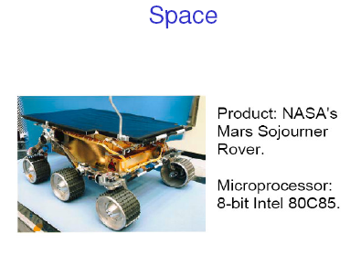
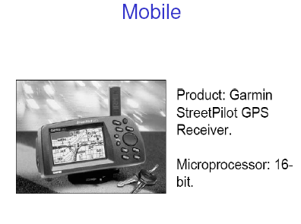
Application Examples

Slide 14
Complex systems and Microprocessors

Slide 15
Embedding Computers
Whirlwind was also the first computer designed to support real-time operation and was originally conceived as a mechanism for controlling an aircraft simulator.
A microprocessor is a single-chip CPU.
Very large scale integration (VLSI) has allowed us to put a complete CPU on a single chip
The first microprocessor, the Intel 4004, was designed for an embedded application. It is called a calculator.

Slide 16
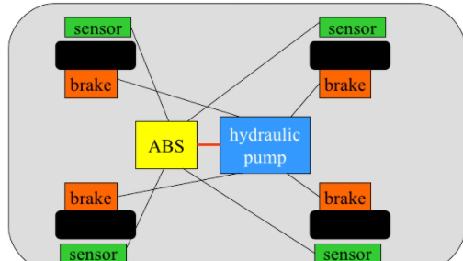
Example: BMW 850i braking and control system

Slide 17
The BMW 850i was introduced with a sophisticated system for controlling the wheels of the car.
An antilock brake system (ABS) reduces skidding by pumping the brakes.
An automatic stability control (ASC T) system intervenes with the engine during maneuvering to improve the car’s stability.
These systems actively control critical systems of the car; as control systems, they require inputs from and output to the automobile.

Slide 18
Embedding a computer
output
analog
CPU
input
analog
mem
embedded
computer

Slide 19
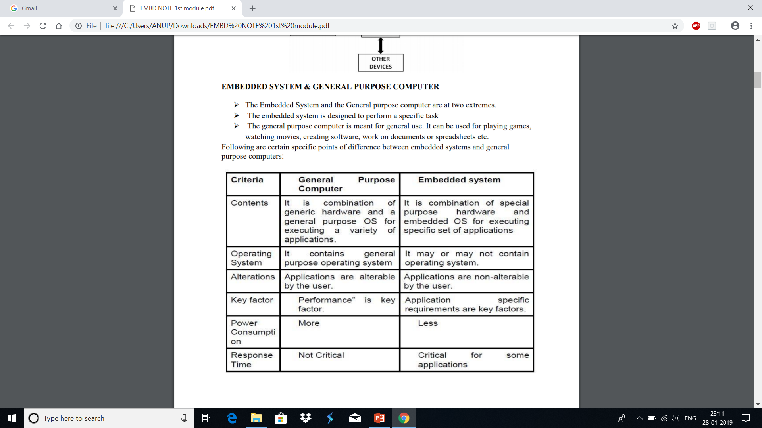

Slide 20
Characteristics of embedded systems
Complex algorithms: Sophisticated functionality.
  Example : For example, the microprocessor that controls an automobile engine must perform complicated filtering functions to optimize the performance of the car while minimizing pollution and fuel utilization.
User interface: complex interface
  Example: options. The moving maps in Global Positioning System (GPS) navigation.

Slide 21
Real-time operation: system must follow deadline
  If data not available on time system will crash
  Failure to meet deadline may be unsafe to even lives.
  May result in unhappy customers
Multirate : several real time activities with different speed rate. All should be synchronized.
  Example: video and audio working together
Low manufacturing cost: depends on microprocessor, memory and input output devices.
Low power and energy(heat).

Slide 22
Functional complexity
Often have to run sophisticated algorithms or multiple algorithms.
  Cell phone, laser printer.
Often provide sophisticated user interfaces.

Slide 23
Real-time operation
Must finish operations by deadlines.
  Hard real time: missing deadline causes failure.
  Soft real time: missing deadline results in degraded performance.
Many systems are multi-rate: must handle operations at widely varying rates.

Slide 24
Non-functional requirements
Many embedded systems are mass-market items that must have low manufacturing costs.
  Limited memory, microprocessor power, etc.
Power consumption is critical in battery-powered devices.
  Excessive power consumption increases system cost even in wall-powered devices.

Slide 25
Design teams
Often designed by a small team of designers.
Often must meet tight deadlines.

Slide 26
Why use microprocessors?
Alternatives: field-programmable gate arrays (FPGAs), custom logic, etc.
Microprocessors are often very efficient: can use same logic to perform many different functions.
Microprocessors simplify the design of families of products.
There are two factors that work together to make microprocessor-based designs fast
  Microprocessors execute programs very efficiently. Parallelism can be employed to make faster processing.
  Microprocessor manufacturers spend a great deal of money to make their CPUs run very fast.

Slide 27
Several functions can be implemented on a single chip. Hence cost effective.
we can modify the programs stored inside the microprocessor.
Program design and hardware design can be done separately and parallelly.
Family of products require only program change without hardware change.

Slide 28
Microprocessors | Microcontroller
Microprocessors are multitasking in nature. Can perform multiple tasks at a time. For example, on computer we can play music while writing text in text editor. | Single task oriented. For example, a washing machine is designed for washing clothes only.
RAM, ROM, I/O Ports, and Timers can be added externally and can vary in numbers. | RAM, ROM, I/O Ports, and Timers cannot be added externally. These components are to be embedded together on a chip and are fixed in numbers.
Designers can decide the number of memory or I/O ports needed. | Fixed number for memory or I/O makes a microcontroller ideal for a limited but specific task
External support of external memory and I/O ports makes a microprocessor-based system heavier and costlier. | Microcontrollers are lightweight and cheaper than a microprocessor.
External devices require more space and their power consumption is higher. | A microcontroller-based system consumes less power and takes less space.

Slide 29
Challenges in embedded system design
How much hardware do we need?
  We need to select not only microprocessors but also amount of memory, peripheral devices etc.
  Too little hardware will cause the system to fail.
  Too much hardware will make the system expensive
How do we meet our deadlines?
  Need to decide whether we can speed up the CPU by increasing the clock rate or by increasing the amount of memory.
How do we minimize power?
  Excessive power consumption increases the heat dissipation in non battery systems and reduces battery life in battery based systems.
  Power consumption can be reduced by reducing the speed without affecting the deadlines.

Slide 30
Challenges, etc.
How do we design for upgradability?
  Adding new features by changing software
Does it really work?
  Is the specification correct?
  Does the implementation meet the spec?
  How do we test for real-time characteristics?
  How do we test on real data?
How do we work on the system?
  Observability, controllability?
  What is our development platform?

Slide 31
Why embedded system design is difficult?
Complex testing
  Need to get real time data
  Timing of data collection is also important
  Need to testing on the embedded system itself
Limited observability and controllability:
  No keyboard and screen. Hence difficult to observe what is going on in the system.
Restricted development environments:
  Usually do the programs in pc and put into embedded machine.

Slide 32
The performance paradox
Microprocessors use much more logic to implement a function than does custom logic.
But microprocessors are often at least as fast:
  heavily pipelined;
  VLSI technology.

Slide 33
What does “performance” mean?
In general-purpose computing, performance often means average-case, may not be well-defined.
The main concept behind embedded computing is real time computing.
Deadline is important in real time computing
It is the time by which the work has to be completed.
In real-time systems, performance means meeting deadlines.
  Missing the deadline by even a little is bad.
  Finishing ahead of the deadline may not help.

Slide 34
Layers in an Embedded System
CPU: The CPU influences the behavior of the program, particularly when the CPU is a pipelined processor with a cache.
Platform: The platform includes the bus and I/O devices. The platform components that surround the CPU are responsible for feeding the CPU and can dramatically affect its performance.
Program: Programs are very large and the CPU sees only a small window of the program at a time.
Task: We generally run several programs simultaneously on a CPU, creating a multitasking system. The tasks interact with each other

Slide 35
Multiprocessor: Many embedded systems have more than one processors, they may include multiple programmable CPUs as well as accelerators which interacts each other.

Slide 36
EMBEDDED SYSTEM DESIGN PROCESS

Slide 37
Objective of Embedded System Design Process
It will give us an introduction to the various steps in embedded system design
It will allow us to consider the design methodology itself

Slide 38
Importance of design methodology
It allows us to keep a scorecard on a design to ensure that we have done everything we need to do
It allows us to develop computer-aided design tools
A design methodology makes it much easier for members of a design team to communicate
By defining the overall process, team members can more easily understand what they are supposed to do, what they should receive from other team members at certain times, and what they are to hand off when they complete their assigned steps

Slide 39
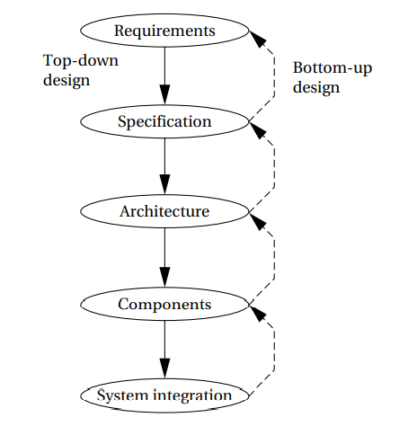
Steps in design process

Slide 40
Requirements:
  Collect the requirements
Specification
  Tells how the system behaves
Architecture
  Gives the details of the systems internal structure.
Components
  Decide the components and create any software or hardware we need
System integration
  Integrate the components to make a complete system

Slide 41
Types of product development methodology
Top-down design:
  start from most abstract description;
  work to most detailed.
Bottom-up design:
  work from small components to big system.
Real design uses both techniques.

Slide 42
Major Design goals
Performance.
  Overall speed, deadlines.
Functionality and user interface.
Manufacturing cost.
Power consumption.
Other requirements (physical size, etc.)

Slide 43
Stepwise refinement
At each level of abstraction, we must:
  Analyze the design to determine characteristics of the current state of the design;
  Refine the design to add detail.
  Verify the design to ensure that it still meets all system goals

Slide 44
Requirements
An informal description obtained from the customers
Plain language description of what the user wants and expects to get.
May be developed in several ways:
  talking directly to customers;
  talking to marketing representatives;
  providing prototypes to users for comment.

Slide 45
Functional vs. non-functional requirements
Functional requirements:
  Output that should be obtained from the system
  It is a function of input.
Non-functional requirements:
  Performance: time required to compute output, deadline by which a process should be completed
  Cost: it is the purchase price. Cost is of two types.
    Manufacturing cost: cost of components and assembly
    Non recurring Engineering cost: personal and cost in designing the system.

Slide 46
  Physical size, weight: depends on application
  Power consumption: important for battery powered device
  reliability;
  etc.

Slide 47
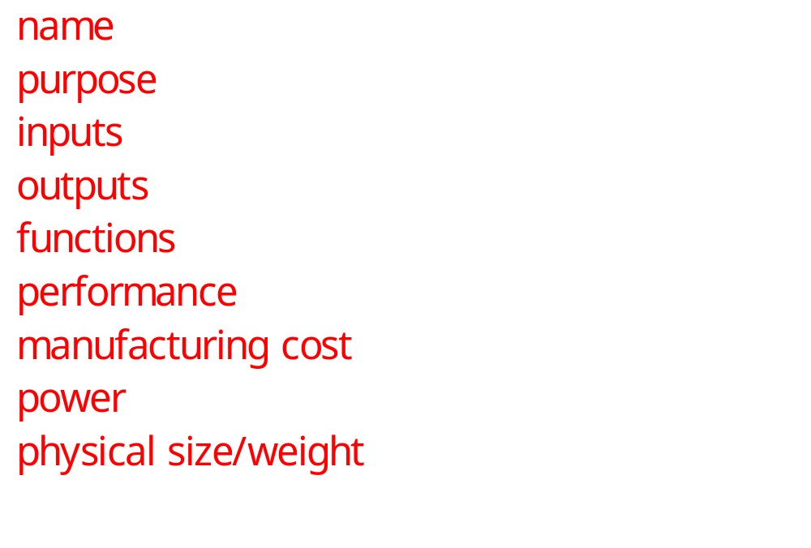
Our requirements form

Slide 48
Requirement form
Name: Name of the project
Purpose: what the system is supposed to do
Inputs and outputs: Specifies the type of data, Data characteristics, Types of I/O devices.
Functions: description of what the system do
Functions: computation must be performed within a time frame
Manufacturing cost: cost of hardware components
Power: decide whether battery powered or not
Physical size and weight

Slide 49
GPS moving map needs
Functionality: For automotive use. Show major roads and landmarks.
User interface: At least 400 x 600 pixel screen. Three buttons max. Pop-up menu.
Performance: Map should scroll smoothly. No more than 1 sec power-up. Lock onto GPS within 15 seconds.
Cost: $120 street price = approx. $30 cost of goods sold.

Slide 50
GPS moving map needs, cont’d.
Physical size/weight: Should fit in hand.
Power consumption: Should run for 8 hours on four AA batteries.

Slide 51
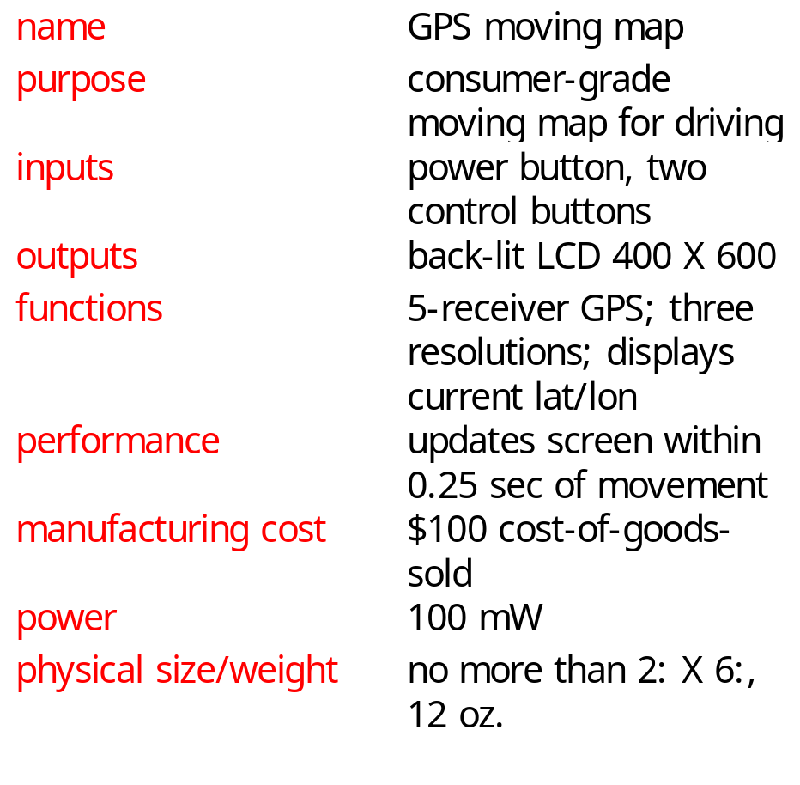
GPS moving map requirements form

Slide 52
Specification
A more precise description of the system:
  should not imply a particular architecture;
  provides input to the architecture design process.
It accurately reflects the customer’s requirements and does so in a way that can be clearly followed during design.
It should be understandable enough so that someone can verify that it meets system requirements and overall expectations of the customer.
It should also be unambiguous enough that designers know what they need to build.

Slide 53
GPS specification
Should include:
  What is received from GPS;
  map data;
  user interface;
  operations required to satisfy user requests;
  background operations needed to keep the system running.

Slide 54
Architecture design
The specification does not say how the system does things, only what the system does.
Describing how the system implements those functions is the purpose of the architecture.
The architecture is a plan for the overall structure of the system that will be used later to design the components that make up the architecture.
Hardware components:
  CPUs, peripherals, etc.
Software components:
  major programs and their operations.
Must take into account functional and non-functional specifications.

Slide 55
GPS moving map block diagram
GPS
receiver
search
engine
renderer
display
database
user
interface

Slide 56
GPS moving map hardware architecture
display
frame
buffer
CPU
GPS
receiver
memory
panel I/O

Slide 57
GPS moving map software architecture
position
database
search
renderer
pixels
user
interface
timer

Slide 58
Designing hardware and software components
Must spend time architecting the system before you start coding.
Some components are ready-made, some can be modified from existing designs, others must be designed from scratch.

Slide 59
System integration
Put together the components.
  Many bugs appear only at this stage.
Have a plan for integrating components to uncover bugs quickly, test as much functionality as early as possible.

Slide 60
FORMALISMS FOR SYSTEM DESIGN
Structural and behavioral description.

Slide 61
Introduction
The different phases of embedded system design can be conceptualize using UML diagram for better understanding.
UML is useful because it encourages design by successive refinement and progressively adding detail to the design

Slide 62
UML
UML is an object-oriented modeling language.
Object oriented modelling emphasizes two cocepts
  It encourages the design to be described as a number of interacting objects,
  At least some of those objects will correspond to real pieces of software or hardware in the system.
  We can also use UML to model the outside world that interacts with our system

Slide 63
OO Specification
Object-oriented specification allows a system to be described in a way that closely models real-world objects and their interactions.
Object-oriented specification provides a basic set of primitives that can be used to describe systems with particular attributes.

Slide 64
Structural Description
Object: The principal component of an object-oriented design is, naturally enough, the object
An object includes a set of attributes that define its internal state
Object has a unique name and is part of a class
Underlined name is an object

Slide 65
UML object
object name
class name
d1: Display
pixels is a
2-D array
pixels: array[] of pixels
elements
menu_items
comment
attributes

Slide 66
All objects derived from the same class have the same characteristics, although their attributes may have different values.
A class defines the attributes that an object may have.
It also defines the operations that determine how the object interacts with the rest of the world

Slide 67
UML class
Display
class name
pixels
elements
menu_items
attribute name
mouse_click()
draw_box
operations

Slide 68
The class interface
The operations provide the abstract interface between the class’s implementation and other classes.
Operations may have arguments, return values.
An operation can examine and/or modify the object’s state.

Slide 69
Choose your interface properly
If the interface is too small/specialized:
  object is hard to use for even one application;
  even harder to reuse.
If the interface is too large:
  class becomes too cumbersome for designers to understand;
  implementation may be too slow;
  spec and implementation are probably buggy.

Slide 70
Relationships between objects and classes
Association: objects communicate but one does not own the other.
Aggregation: a complex object is made of several smaller objects.
Composition: aggregation in which owner does not allow access to its components.
Generalization: define one class in terms of another.

Slide 71
Class derivation
May want to define one class in terms of another.
  Derived class inherits attributes, operations of base class.
Derived_class
UML
generalization
Base_class

Slide 72
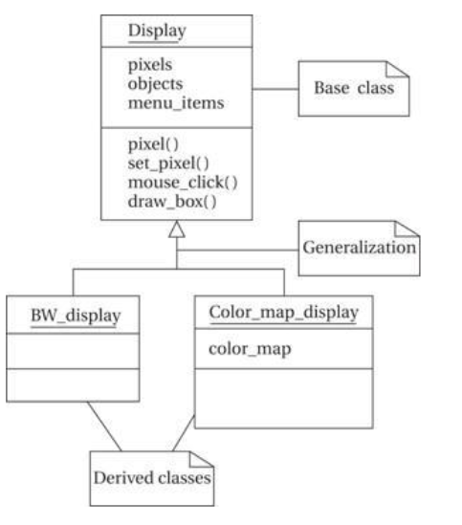
Class derivation example

Slide 73
The first, BW_display, describes a blackand-white display. This does not require us to add new attributes or operations, but we can specialize both to work on one-bit pixels.
The second,Color_map_display, uses a graphic device known as a color map to allow the user to select from a large number of available colors even with a small number of bits per pixel. This class defines a color_map attribute that determines how pixel values are mapped onto display colors.

Slide 74
Inheritance
A derived class inherits all the attributes and operations from its base class.
Purpose of inheritance is
  shares some characteristics with another class
  it captures those relationships between classes and documents them

Slide 75
Generalization
Unified Modeling Language considers inheritance to be one form of generalization.
A generalization relationship is shown in a UML diagram as an arrow with an open (unfilled) arrowhead.

Slide 76
Multiple inheritance
base classes
Speaker
Display
Multimedia_display
derived class

Slide 77
Links and associations
Link: describes relationships between objects.
Association: describes relationship between classes.

Slide 78
Link example
Link defines the contains relationship:
message
msg = msg1
length = 1102
message set
count = 2
message
msg = msg2
length = 2114

Slide 79
Association example
# contained messages
# containing message sets
message
message set
0..*
1
msg: ADPCM_stream
length : integer
count : integer
contains

Slide 80
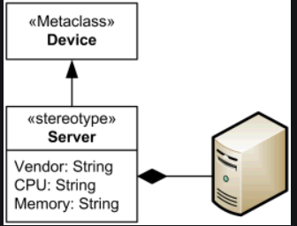
Stereotypes
Stereotype: recurring combination of elements in an object or class.
we find that we use a certain combination of elements in an object or class many times which are called stereotypes
Example:

Slide 81
Behavioral description
Several ways to describe behavior:
  internal view;
  external view.

Slide 82
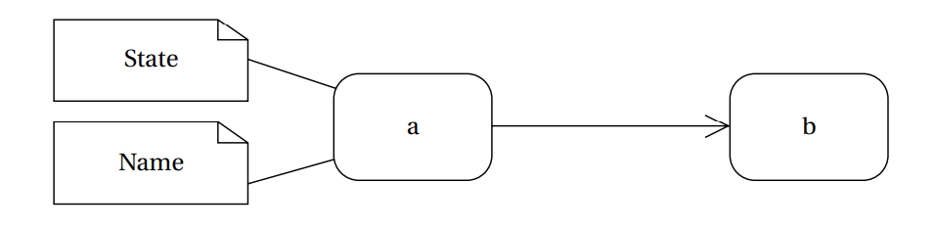
State machines

Slide 83
Event-driven state machines
Behavioral descriptions are written as event-driven state machines.
  Machine changes state when receiving an input.
Event is an action
An event may come from inside(finishes one routine and give its result to another for continuation of that routine) or outside of the system(pressing button).

Slide 84
Types of events
Signal: asynchronous event.
  It is defined in UML by an object that is labeled as a <<signal>>.
  The object in the diagram serves as a declaration of the event’s existence.
  Because it is an object, a signal may have parameters that are passed to the signal’s receiver.
Call: synchronized communication.
  follows the model of a procedure call in a programming language.
Timer: activated by time.
  causes the machine to leave a state after a certain amount of time.
  The label tm(time-value) on the edge gives the amount of time after which the transition occurs.

Slide 85
Signal event
<<signal>>
mouse_click
a
leftorright: button
x, y: position
mouse_click(x,y,button)
b
declaration
event description

Slide 86
Call event
draw_box(10,5,3,2,blue)
c
d

Slide 87
Timer event
tm(time-value)
e
f

Slide 88
Example state machine
start
input/output
mouse_click(x,y,button)/
find_region(region)
region = menu/
which_menu(i)
call_menu(I)
region
found
got menu
item
called
menu item
region = drawing/
find_object(objid)
highlight(objid)
found
object
object
highlighted
finish

Slide 89
The start and stop states are special states that help us to organize the flow of the state machine.
The states in the state machine represent different conceptual operations.
In some cases, we take conditional transitions out of states based on inputs or the results of some computation done in the state.
In other cases, we make an unconditional transition to the next state.
Both the unconditional and conditional transitions make use of the call event.
Splitting a complex operation into several states helps document the required steps, much as subroutines can be used to structure code.

Slide 90
Sequence diagram
Shows sequence of operations over time.
Relates behaviors of multiple objects.

Slide 91
Sequence diagram example
m: Mouse
d1: Display
u: Menu
mouse_click(x,y,button)
which_menu(x,y,i)
time
call_menu(i)

Slide 92
Summary
Object-oriented design helps us organize a design.
UML is a transportable system design language.
  Provides structural and behavioral description primitives.

Slide 93
Introduction
Example: model train controller.

Slide 94
Purposes of example
Follow a design through several levels of abstraction.
Gain experience with UML.

Slide 95
Model train setup
rcvr
motor
power
supply
console
ECC
command
address
header

Slide 96
Requirements
Console can control 8 trains on 1 track.
Throttle has at least 63 levels.
Inertia control adjusts responsiveness with at least 8 levels.
Emergency stop button.
Error detection scheme on messages.

Slide 97
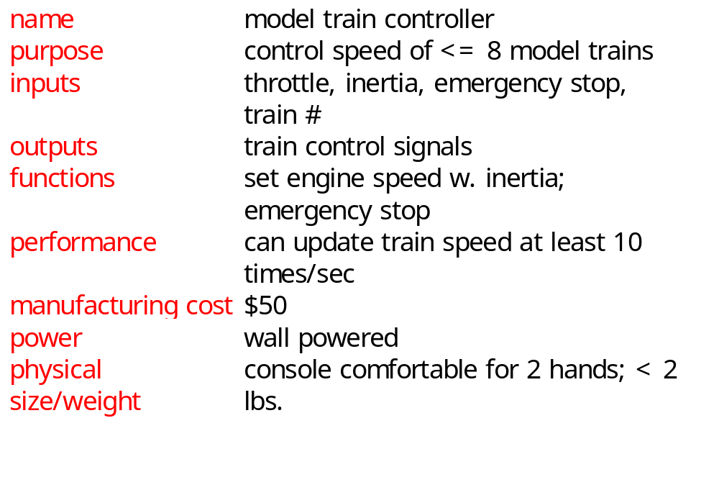
Requirements form

Slide 98
Digital Command Control
DCC created by model railroad hobbyists, picked up by industry.
Defines way in which model trains, controllers communicate.
  Leaves many system design aspects open, allowing competition.
This is a simple example of a big trend:
  Cell phones, digital TV rely on standards.

Slide 99
DCC documents
Standard S-9.1, DCC Electrical Standard.
  Defines how bits are encoded on the rails.
Standard S-9.2, DCC Communication Standard.
  Defines packet format and semantics.

Slide 100
DCC electrical standard
Voltage moves around the power supply voltage; adds no DC component.
1 is 58 μs, 0 is at least 100 μs.
logic 1
logic 0
time
58 μs
>= 100 μs

Slide 101
DCC communication standard
Basic packet format: PSA(sD)+E.
P: preamble = 1111111111.
S: packet start bit = 0.
A: address data byte.
s: data byte start bit.
D: data byte (data payload).
E: packet end bit = 1.

Slide 102
DCC packet types
Baseline packet: minimum packet that must be accepted by all DCC implementations.
  Address data byte gives receiver address.
  Instruction data byte gives basic instruction.
  Error correction data byte gives ECC.

Slide 103
Conceptual specification
Before we create a detailed specification, we will make an initial, simplified specification.
  Gives us practice in specification and UML.
  Good idea in general to identify potential problems before investing too much effort in detail.

Slide 104
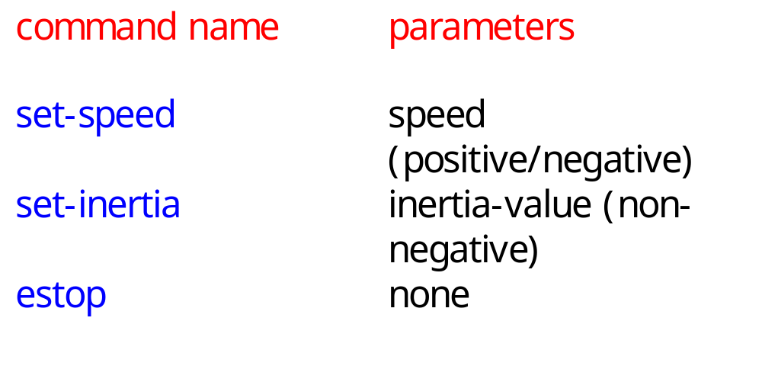
Basic system commands

Slide 105
Typical control sequence
:console
:train_rcvr
set-inertia
set-speed
set-speed
estop
set-speed

Slide 106
Message classes
command
set-speed
set-inertia
estop
value: integer
value: unsigned-
integer

Slide 107
Roles of message classes
Implemented message classes derived from message class.
  Attributes and operations will be filled in for detailed specification.
Implemented message classes specify message type by their class.
  May have to add type as parameter to data structure in implementation.

Slide 108
Subsystem collaboration diagram
Shows relationship between console and receiver (ignores role of track):
1..n: command
:console
:receiver

Slide 109
System structure modeling
Some classes define non-computer components.
  Denote by *name.
Choose important systems at this point to show basic relationships.

Slide 110
Major subsystem roles
Console:
  read state of front panel;
  format messages;
  transmit messages.
Train:
  receive message;
  interpret message;
  control the train.

Slide 111
Console system classes
console
1
1
1
1
1
1
panel
formatter
transmitter
1
1
1
1
receiver*
sender*

Slide 112
Console class roles
panel: describes analog knobs and interface hardware.
formatter: turns knob settings into bit streams.
transmitter: sends data on track.

Slide 113
Train system classes
train set
1
1..t
1
1
train
1
1
motor
interface
receiver
1
1
1
controller
1
1
1
detector*
pulser*

Slide 114
Train class roles
receiver: digitizes signal from track.
controller: interprets received commands and makes control decisions.
motor interface: generates signals required by motor.

Slide 115
Detailed specification
We can now fill in the details of the conceptual specification:
  more classes;
  behaviors.
Sketching out the spec first helps us understand the basic relationships in the system.

Slide 116
Train speed control
Motor controlled by pulse width modulation:
duty
cycle
+
V
-

Slide 117
Console physical object classes
knobs*
pulser*
train-knob: integer
speed-knob: integer
inertia-knob: unsigned-
integer
emergency-stop: boolean
pulse-width: unsigned-
integer
direction: boolean
sender*
detector*
send-bit()
read-bit() : integer

Slide 118
Panel and motor interface classes
panel
motor-interface
speed: integer
train-number() : integer
speed() : integer
inertia() : integer
estop() : boolean
new-settings()

Slide 119
Class descriptions
panel class defines the controls.
  new-settings() behavior reads the controls.
motor-interface class defines the motor speed held as state.

Slide 120
Transmitter and receiver classes
transmitter
receiver
current: command
new: boolean
send-speed(adrs: integer,
speed: integer)
send-inertia(adrs: integer,
val: integer)
set-estop(adrs: integer)
read-cmd()
new-cmd() : boolean
rcv-type(msg-type:
command)
rcv-speed(val: integer)
rcv-inertia(val:integer)

Slide 121
Class descriptions
transmitter class has one behavior for each type of message sent.
receiver function provides methods to:
  detect a new message;
  determine its type;
  read its parameters (estop has no parameters).

Slide 122
Formatter class
formatter
current-train: integer
current-speed[ntrains]: integer
current-inertia[ntrains]:
unsigned-integer
current-estop[ntrains]: boolean
send-command()
panel-active() : boolean
operate()

Slide 123
Formatter class description
Formatter class holds state for each train, setting for current train.
The operate() operation performs the basic formatting task.

Slide 124
Control input cases
Use a soft panel to show current panel settings for each train.
Changing train number:
  must change soft panel settings to reflect current train’s speed, etc.
Controlling throttle/inertia/estop:
  read panel, check for changes, perform command.

Slide 125
Control input sequence diagram
:knobs
:panel
:formatter
:transmitter
change in
control
settings
read panel
panel-active
change in speed/
inertia/estop
panel settings
send-command
read panel
send-speed,
send-inertia.
send-estop
panel settings
read panel
change in
train
number
change in
train number
panel settings
new-settings
set-knobs

Slide 126
Formatter operate behavior
update-panel()
panel-active()
new train number
idle
send-command()
other

Slide 127
Panel-active behavior
T
current-train = train-knob
update-screen
changed = true
panel*:read-train()
F
T
current-speed = throttle
changed = true
panel*:read-speed()
F
...
...

Slide 128
Controller class
controller
current-train: integer
current-speed[ntrains]: integer
current-direction[ntrains]: boolean
current-inertia[ntrains]:
unsigned-integer
operate()
issue-command()

Slide 129
Setting the speed
Don’t want to change speed instantaneously.
Controller should change speed gradually by sending several commands.

Slide 130
Sequence diagram for set-speed command
:receiver
:controller
:motor-interface
:pulser*
new-cmd
cmd-type
rcv-speed
set-speed
set-pulse
set-pulse
set-pulse
set-pulse
set-pulse

Slide 131
Controller operate behavior
wait for a
command
from receiver
receive-command()
issue-command()

Slide 132
Refined command classes
command
type: 3-bits
address: 3-bits
parity: 1-bit
set-speed
set-inertia
estop
type=010
value: 7-bits
type=001
value: 3-bits
type=000

Slide 133
Summary
Separate specification and programming.
  Small mistakes are easier to fix in the spec.
  Big mistakes in programming cost a lot of time.
You can’t completely separate specification and architecture.
  Make a few tasteful assumptions.

